Slide 1


Applied Virtual Networks
COMP 4912
Instructor: Dawood Sajjadi
PhD, SMIEEE, CISSP
ssajjaditorshizi@bcit.ca
Winter-Spring 2025
Week #7

Slide 2
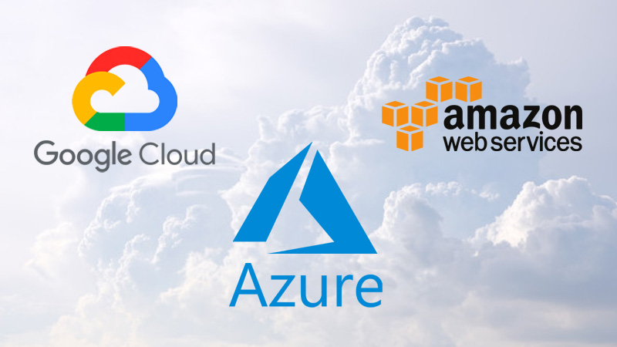
Emergence of Public Clouds
RECAP
Spacelift report (Mar 2024)
Gartner report (Nov 2023)

Slide 3
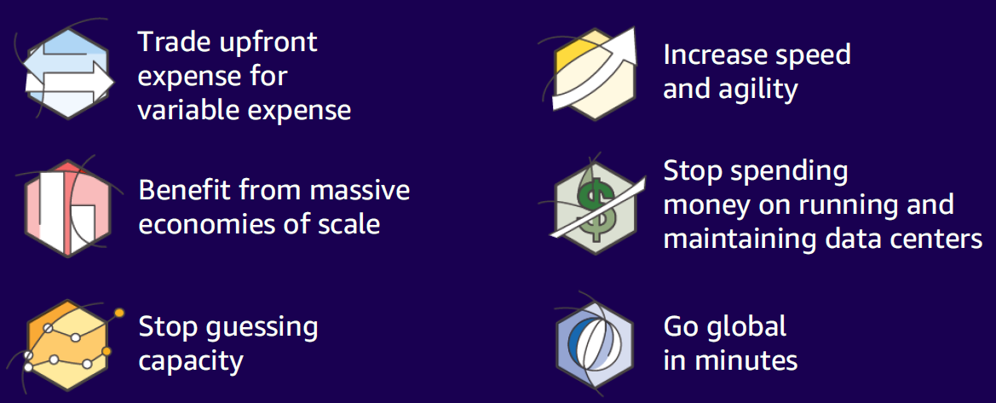
Key advantages of Public Clouds
RECAP
Reference: AWSome Day, Michalynn J. Koziol (2024)

Slide 4
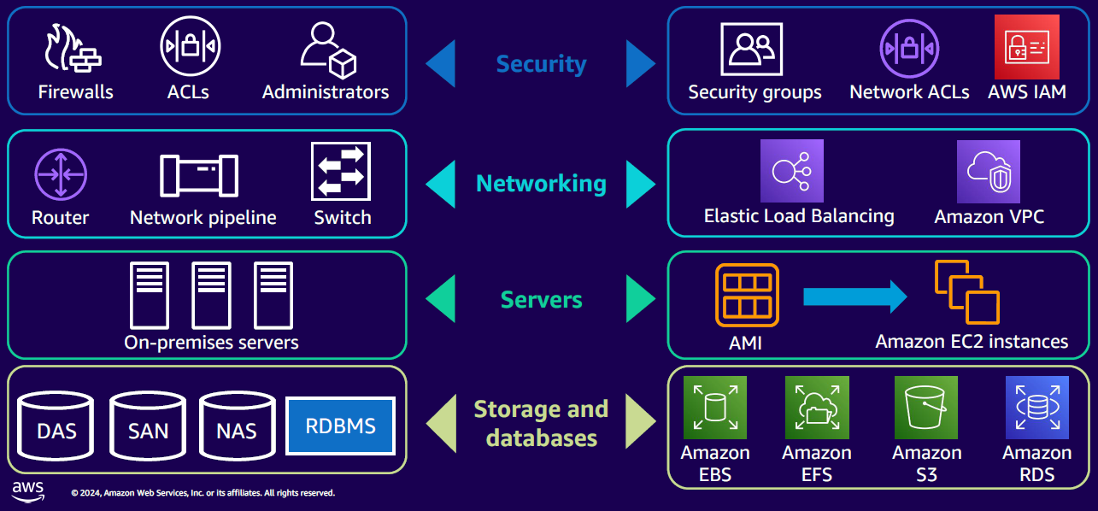
AWS Core Infrastructure-as-a-Service (IaaS)
RECAP
Reference: AWSome Day, Michalynn J. Koziol (2024)

Slide 5
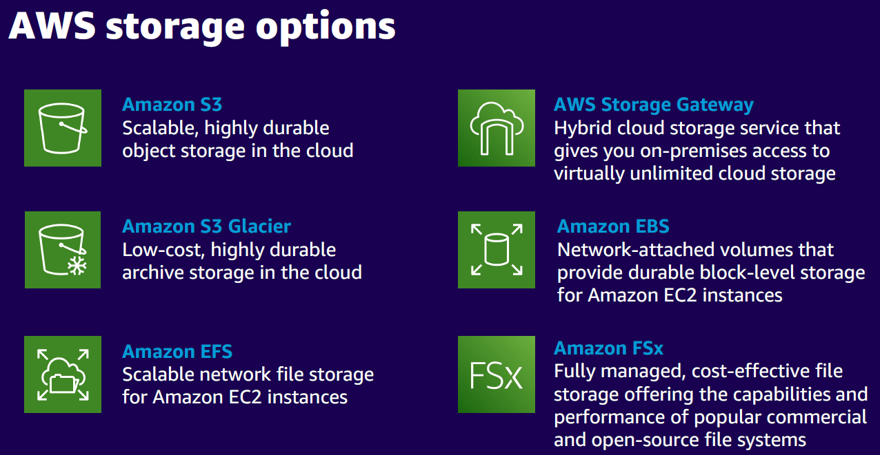
RECAP
Reference: AWSome Day, Michalynn J. Koziol (2024)

Slide 6
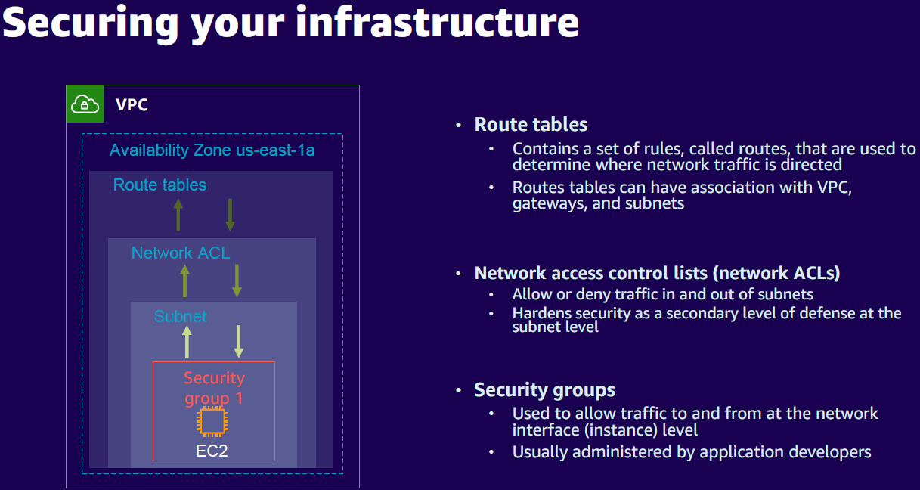
RECAP
Reference: AWSome Day, Michalynn J. Koziol (2024)

Slide 7
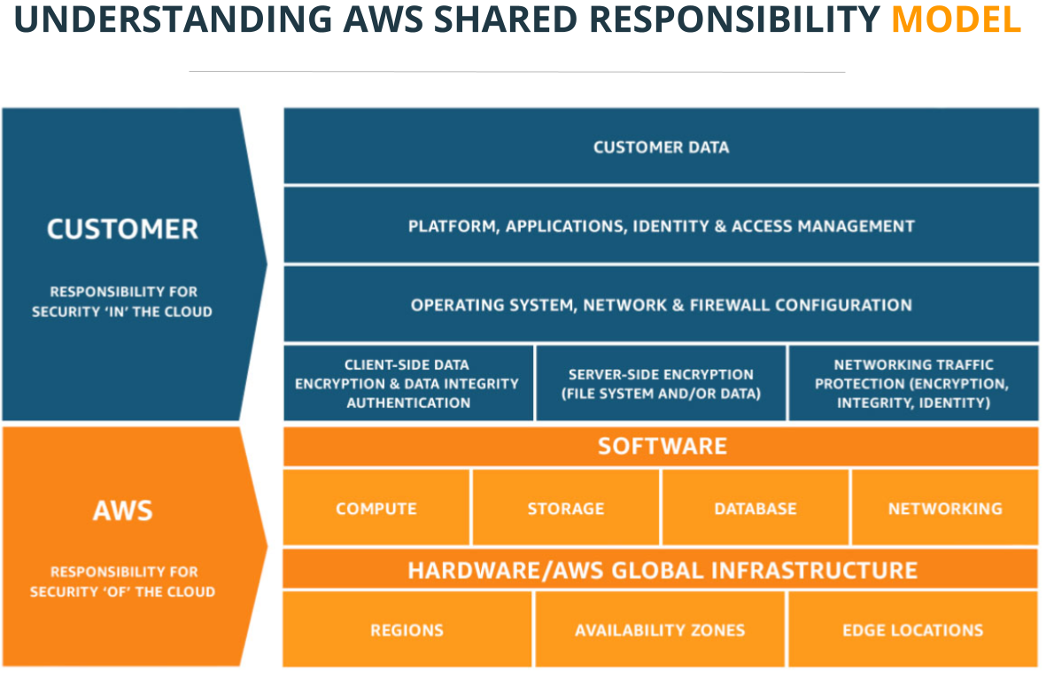
RECAP
https://allcloud.io/blog/aws-security-panel-summary/

Slide 8
Learning Outcomes of Week #7
Understand the core concepts of Automation and Infrastructure-as-Code (IaC).
Learn how to use Ansible to Automate configuration management and software deployment.
Explore Terraform for provisioning and managing infrastructure across cloud providers.
Gain hands-on experience writing simple Ansible playbooks and Terraform configuration files.
Compare and use Ansible and Terraform for end-to-end automation workflows.
Develop skills to implement scalable, repeatable, and efficient automation solutions.

Slide 9



The Ansible project is an open source community sponsored by Red Hat. It uses YAML to perfectly describe IT application environments in Ansible Playbooks. Ansible Engine is a supported product built from the Ansible community project.
What Ansible Does?
Overview of Configuration Management and Automation
Implementing an agentless architecture to manage resources
Simple, YAML-based Playbooks
Agentless Approach
Scalability and Performance
Extensibility with Modules
Key Features
Notes:
Ansible provides an easy way to manage large infrastructures. It enables repeatable, reliable operations by using simple YAML files called playbooks. Its agentless design means fewer resources are consumed, and it is simple to set up. Indeed, Ansible is an open-source tool for automating IT operations. It is agentless, meaning you don’t need to install additional software on managed nodes. Ansible simplifies tasks like configuration management, application deployment, and IT orchestration.

Slide 10
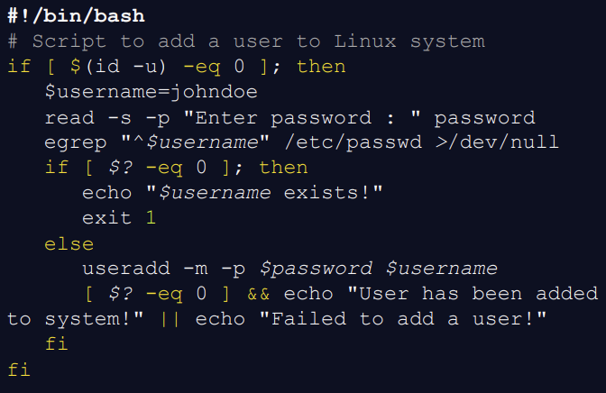
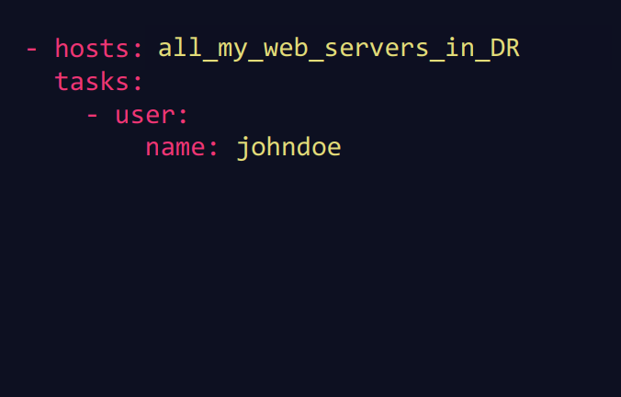
Script vs Ansible Playbook

Slide 11
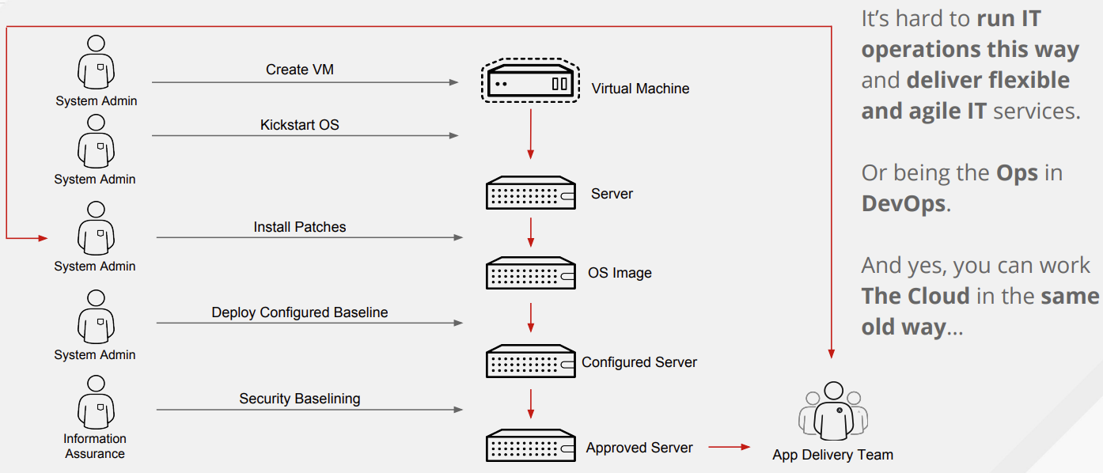
Setting up a Server in the Old Days
https://people.redhat.com/mkoch/training/1806-vienna/presentations/05%20-%20Ansible%20and%20Ansible%20Tower%20Introduction.pdf

Slide 12

Eliminating Toil
https://sre.google/sre-book/eliminating-toil/
Notes:
Toil is the kind of work tied to running a production service that tends to be manual, repetitive, automatable, tactical, devoid of enduring value, and that scales linearly as a service grows.

Slide 13
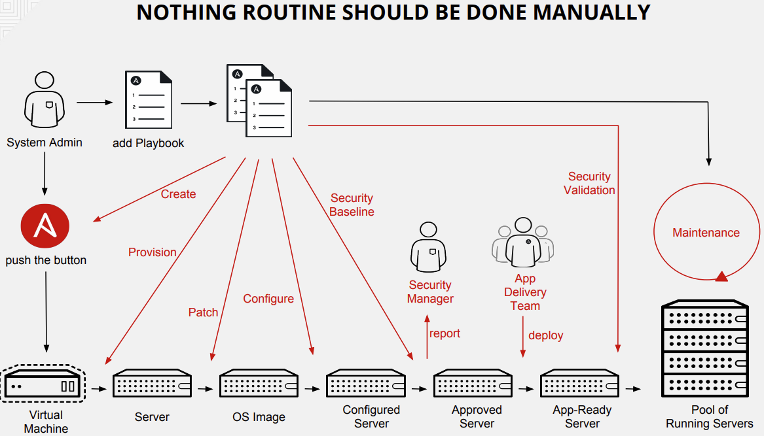

Slide 14
The Importance of Automation in SRE and DevOps
Consistency and Efficiency in Operations
Accelerating Deployment Cycles
Reducing Manual Error
Core Components of Ansible
Playbooks
Inventory
Modules
Roles
Notes:
Automation is critical for modern IT environments. It reduces manual errors, ensures consistency, and speeds up operational tasks like provisioning and configuration.
Playbook: YAML files that define automation tasks and orchestration workflows for managing systems. Inventory: A list or file specifying the hosts and groups of hosts on which Ansible commands and playbooks are executed. Modules: Reusable, task-specific scripts that perform actions on managed nodes. Roles: A way to break down complex tasks into smaller, more manageable pieces. Roles contain lists of tasks that perform the work you’ve configured them to do.

Slide 15
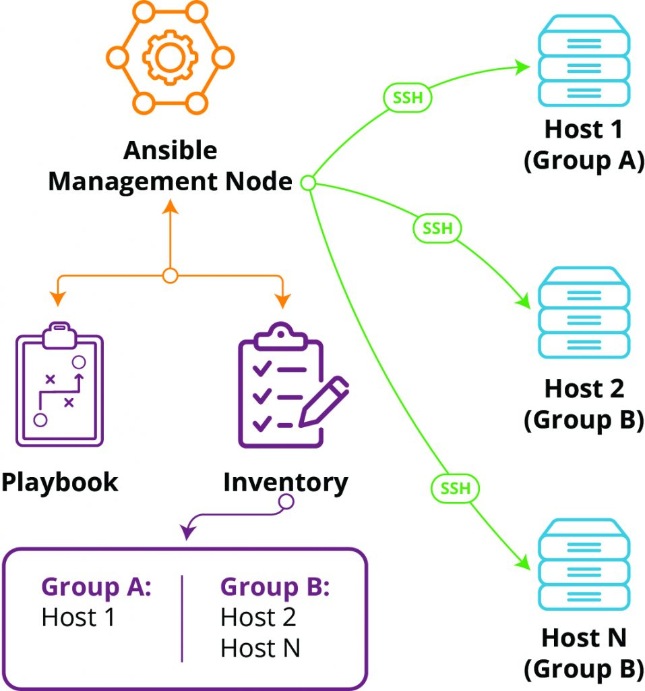
How Ansible Works
Architecture Overview
Execution Flow of an Ansible Playbook
→ Communication via SSH
→ Mostly written in Python
→ It is Agentless (no service running)
Common Use Cases
→ Configuration Management
→ Application Deployment
→ Orchestration of Complex Workflows
Notes:
Ansible operates by connecting to managed nodes via SSH. Tasks are defined in YAML playbooks and executed on target machines in an ordered manner.
Use cases include configuration management (ensuring systems have specific states), application deployment (consistent rollouts), and orchestration of complex tasks like cluster creation.

Slide 16
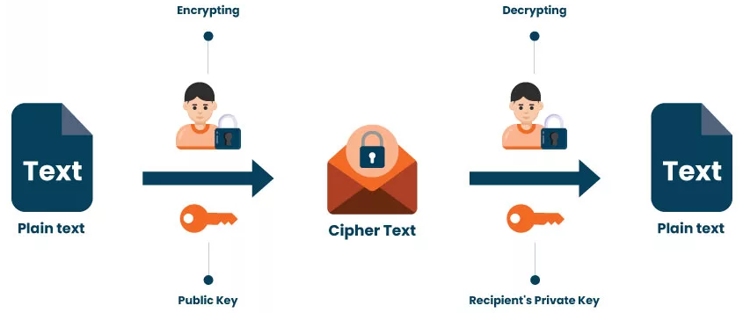
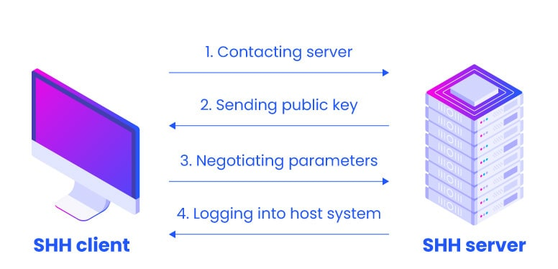
What is SSH (Secure Shell)?
Secure Shell (SSH) is a cryptographic network protocol used to securely access and manage remote systems over an unsecured network.
Encrypts data to prevent eavesdropping.
Enables secure login and command execution on remote machines.
Supports SCP & SFTP for secure file transfer.
Default Port is 22 TCP
$ ssh username@<remote-host>
$ ssh ubuntu@10.11.12.1

Slide 17
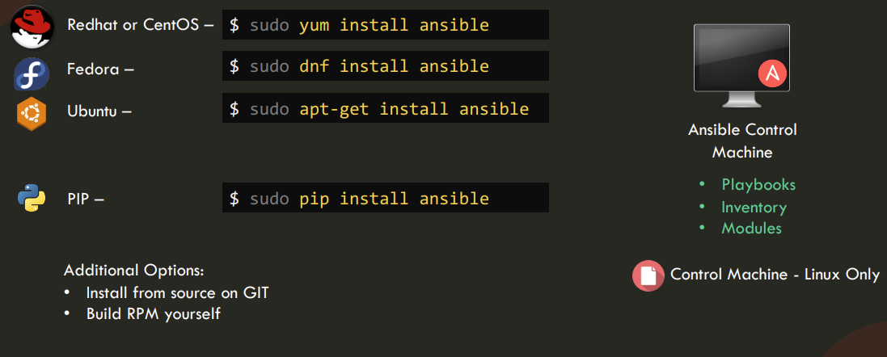
How Ansible Works
Notes:
Ansible operates by connecting to managed nodes via SSH. Tasks are defined in YAML playbooks and executed on target machines in an ordered manner.
Use cases include configuration management (ensuring systems have specific states), application deployment (consistent rollouts), and orchestration of complex tasks like cluster creation.

Slide 18
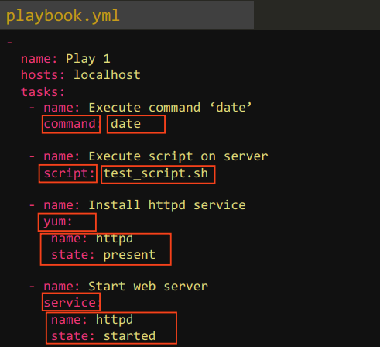
Setting Up Ansible
Installation Requirements
Setting Up the Control Node
Configuring Inventory
Ansible Inventory
Static vs. Dynamic Inventory
Defining Hosts and Groups
Writing the first playbook
Structure of a Playbook
Example: Installing a Package
https://kodekloud.com/wp-content/uploads/2020/10/Ansible-for-Beginners-KodeKloud.pdf
Notes:
Install Ansible on a control node, define managed nodes in an inventory file, and start creating playbooks to define automation tasks.
Inventory files can be static (fixed hostnames) or dynamic (auto-generated). Hosts can be grouped, allowing you to target specific groups of machines.
Playbooks are YAML files that define automation tasks. They include tasks like installing software, managing files, or configuring services.

Slide 19
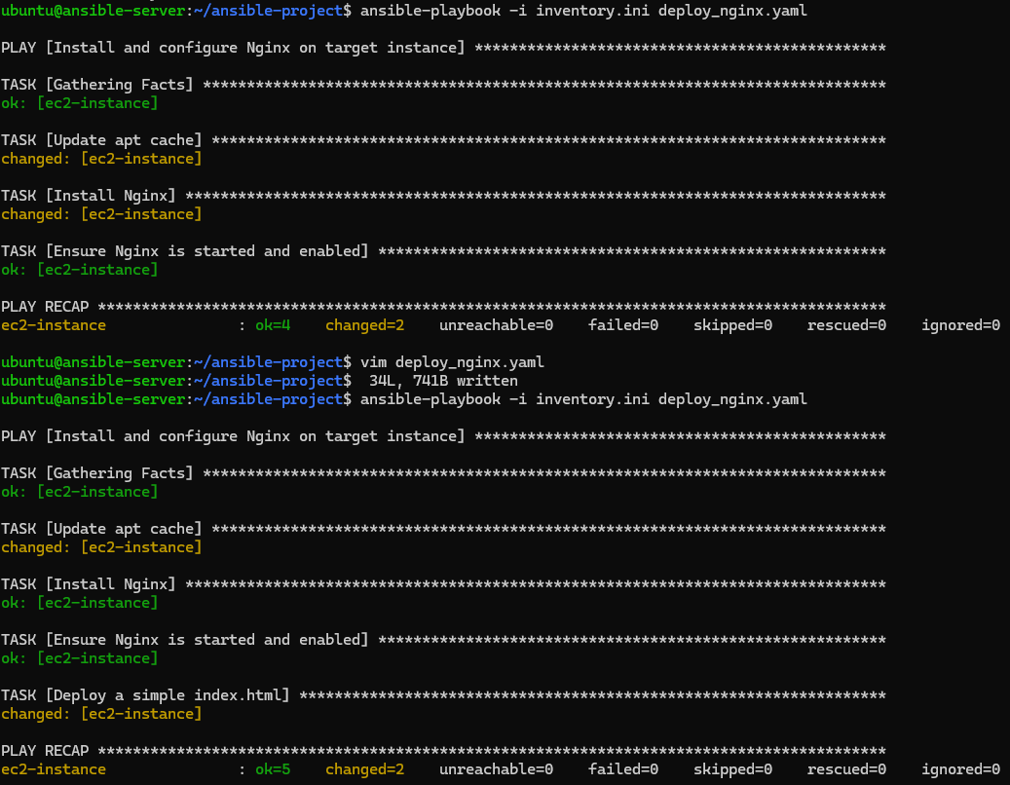
Ansible is Idempotent
Repeated runs produce same result without changes.
Notes:
Most Ansible modules check whether the desired final state has already been achieved, and exit without performing any actions if that state has been achieved, so that repeating the task does not change the final state. Modules that behave this way are often called 'idempotent.'

Slide 20

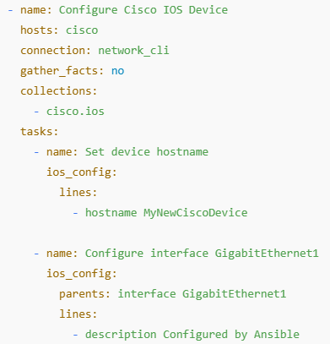
Ansible Galaxy
https://galaxy.ansible.com/
Ansible Galaxy is an online repository where users can find, share, and reuse Ansible roles, modules, and collections.
$ ansible-galaxy collection install cisco.ios
Collections in this yaml file indicates that the playbook is using the Cisco IOS collection (downloaded from Ansible Galaxy). This collection provides the ios_config module and other Cisco-specific modules that enable configuration of Cisco devices.
Community-Driven: Access to thousands of community-contributed roles.
Reusability: Roles and collections help modularize & reuse automation code.
Check These Resources for Ansible 1. https://github.com/ansible-community/awesome-ansible 2. https://ansible.puzzle.ch/ (slides/labs)
3. https://www.env0.com/blog/the-ultimate-ansible-tutorial-a-step-by-step-guide

Slide 21
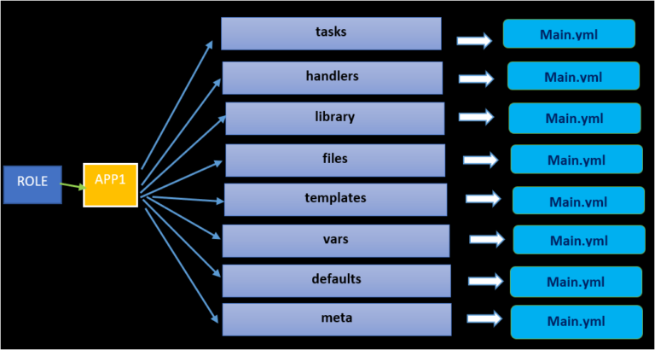
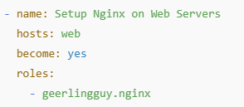
Ansible Roles
You can try the following on Ansible Control node to setup an Nginx Server using an Ansible Galaxy role.
$ ansible-galaxy install geerlingguy.nginx
$ vim website.ymal
$ ansible-playbook -i inventory.ini website.yaml
Visit the following link for further details about this role
https://github.com/geerlingguy/ansible-role-nginx

Slide 22

Ansible docs/exercise
1
To get more information about Ansible, you may visit https://docs.ansible.com/
Create two AWS instances (Ubuntu) and install Ansible in one of them.
Call these instances Ansible-N1 and Ansible-N2, respectively.
Install Ansible on Ansible-N1 using ‘apt update && apt install ansible -y’
Visit the following link and create these file in Ansible-N1 as shown in the class.
https://github.com/5tuxnet/courses/tree/main/comp4912/lab4
Once the file created and SSH access verified, run ‘ansible-playbook -i inventory.ini deploy-nginx.yml’
Try running the following commands from node with Ansible installed:
$ ansible all -i inventory.ini -m ping
$ ansible ec2-instance -i inventory.ini -m shell -a "hostname && uptime“
$ ansbile ec2-instance -i inventory.ini -m reboot --become

Slide 23
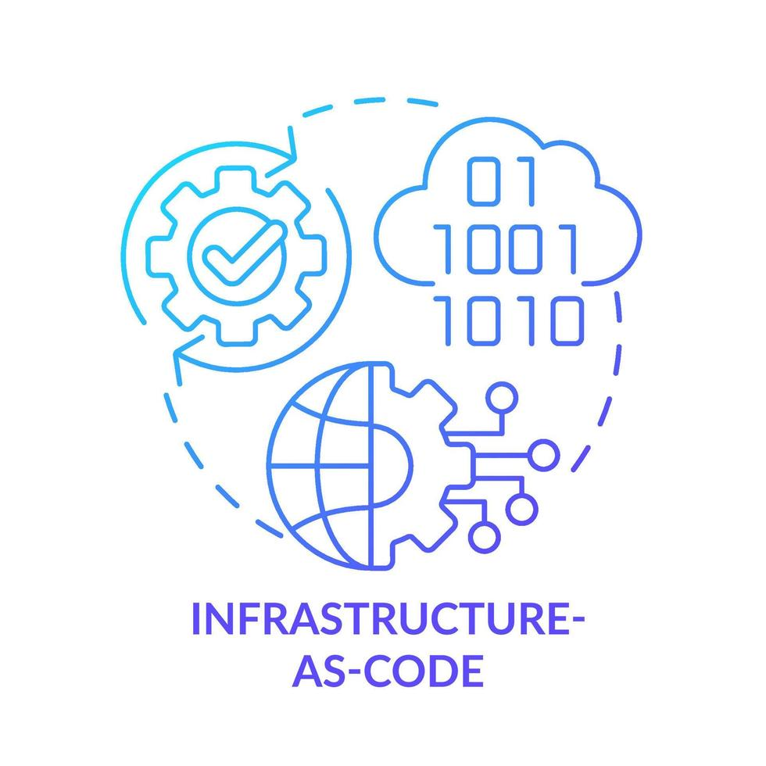
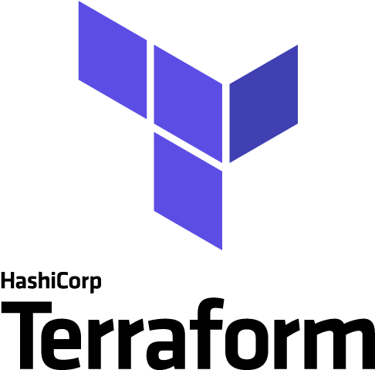
Terraform, the de facto standard for IaC
“Like the principle that the same source code generates the same binary, an Infrastructure as Code (IaC) model generates the same environment every time it is applied.”
Sam Guckenheimer (Product Owner, Azure DevOps)
Infrastructure as Code (IaC)
Support more collaboration between Dev and Ops
More automation, less human error
Traceability and Integrity
Repeatability and agility
Increase Transparency
Notes:
You may want to rebuild your entire cloud infrastructure from time to time, especially let’s say you want run it during especial time of a day for different reason and by terraform you can rebuild your entire infrastructure in matter of seconds or minute.

Slide 24
Terraform, the de facto standard for IaC
Terraform is used to create, manage, and update infrastructure resources such as virtual networks, VMs, security rules, containers, domains and more. Almost any infrastructure type can be represented as a resource in Terraform.
Declarative
Written in Go
Multiplatform
Free Software & Open Source
Freemium (Premium options: GUI, support, …)
HashiCorp Product (https://developer.hashicorp.com/terraform/intro)
It is important to note that Terraform is primarily an IaC tool, designed to provision and manage infrastructure such as servers, networks, and storage, but not to install or configure software on those servers.
Terraform does NOT replace configuration management tools like Ansible.

Slide 25
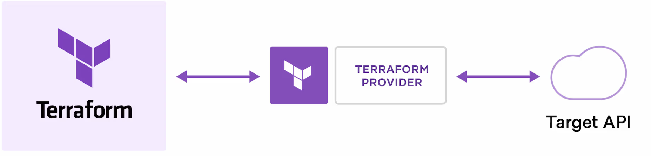
Key benefits of Terraform
Declarative
Automate changes
Expediting DR process
Minimizing Human Errors
Standardize configurations
Stateful (No Agent needed)
Saving resources and money
Version Control for Infrastructure
Multi-cloud support (AWS/GCP/Azure)
Automating building Cloud Infrastructure
Terraform creates and manages resources on cloud platforms and other services through their APIs. Providers enable Terraform to work with virtually any platform or service with an accessible API.
You can find all publicly available Providers on the Terraform Registry, e.g., AWS/GCP/GitHub.
Notes:
You can write your own provider as well.
Standardize configurations - Terraform supports reusable configuration components called modules that define configurable collections of infrastructure, saving time and encouraging best practices. You can use publicly available modules from the Terraform Registry, or write your own.
Stateful (No Agent needed) – Terraform maintains state files to track infrastructure changes without requiring an agent on managed resources. It can track resources and detect changes without using agents. Instead it relies on the state file to manage and update infrastructure.
Version Control for Infrastructure – Terraform configurations are stored as code, enabling versioning, tracking, and collaboration through Git or other VCS. Declarative – Users define the desired state of infrastructure, and Terraform ensures it matches that state without needing step-by-step commands. No Manual ClickOps – Eliminates the need for manual UI-based cloud management by automating infrastructure provisioning with code. Saving Resources and Money – Terraform optimizes resource allocation, automates scaling, and prevents over-provisioning, reducing costs.

Slide 26
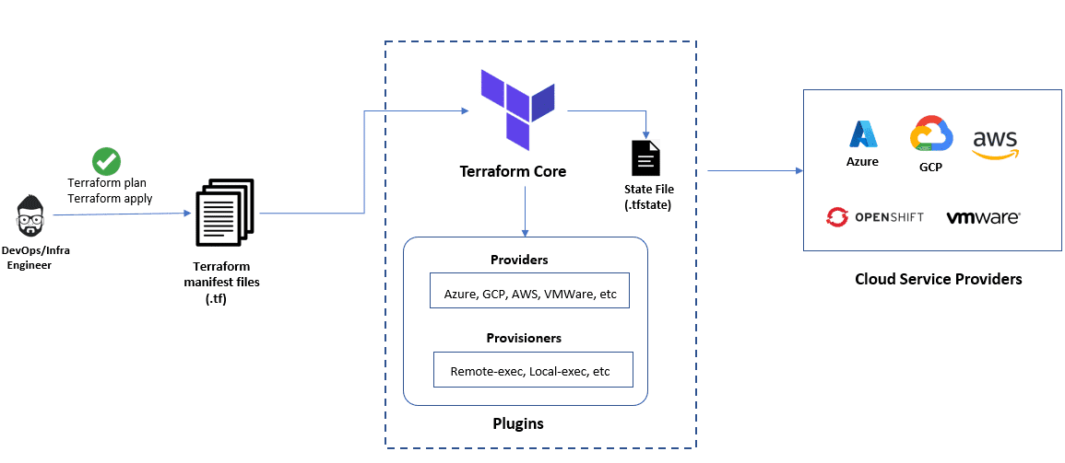
Terraform Architecture
Terraform Core
Providers
State file
https://spacelift.io/blog/terraform-architecture
Notes:
1. Terraform’s core (also known as Terraform CLI) is built on a statically-compiled binary that’s developed using the Go programming language.
This binary is what generates the command line tool (CLI) known as “terraform,” which serves as the primary interface for Terraform users.
2. Terraform providers are modules that enable Terraform to communicate with a diverse range of services and resources, including but not limited to cloud providers, databases, and DNS services. Each provider is responsible for defining the resources that Terraform can manage within a particular service and translating Terraform configurations into API calls that are specific to that service.
3. The Terraform state file is an essential aspect of Terraform’s functionality. It is a JSON file that stores information about the resources that Terraform manages, as well as their current state and dependencies. Terraform utilizes the state file to determine the changes that need to be made to the infrastructure when a new configuration is applied. It also ensures that resources are not unnecessarily recreated across multiple runs of Terraform.

Slide 27
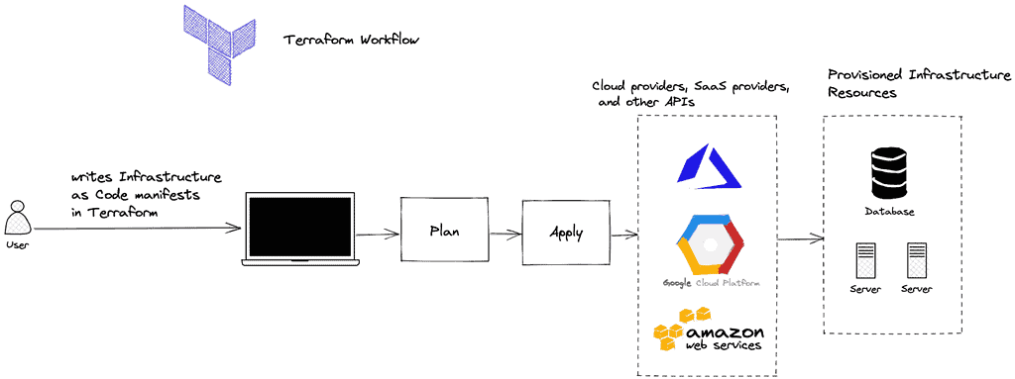
How Terraform Works?
https://k21academy.com/terraform-iac/important-terraform-concepts/
Notes:
Write: You define resources, which may be across multiple cloud providers and services. For example, you might create a configuration to deploy an application on virtual machines in a Virtual Private Cloud (VPC) network with security groups and a load balancer.
Plan: Terraform creates an execution plan describing the infrastructure it will create, update, or destroy based on the existing infrastructure and your configuration.
Apply: On approval, Terraform performs the proposed operations in the correct order, respecting any resource dependencies. For example, if you update the properties of a VPC and change the number of virtual machines in that VPC, Terraform will recreate the VPC before scaling the virtual machines.

Slide 28
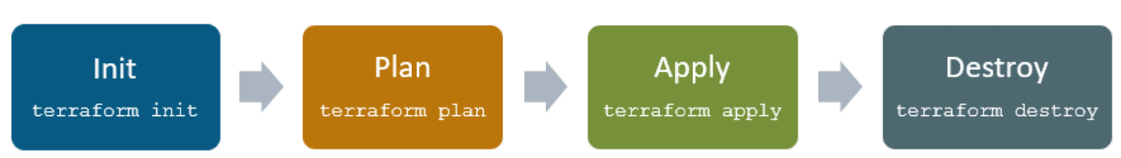
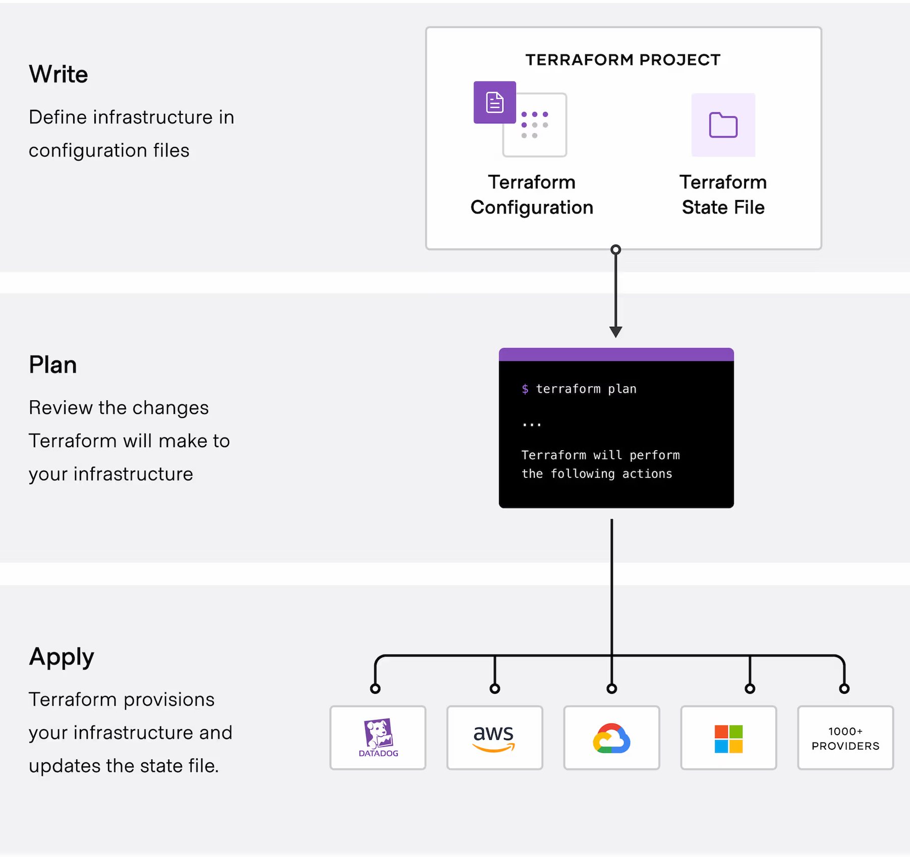
How Terraform Works?
The core Terraform workflow consists of three stages:
Terraform init initializes the (local) Terraform environment. Usually executed only once per session.
Terraform plan compares the Terraform state with the as-is state in the cloud, build and display an execution plan. This does not change the deployment (read-only).
Terraform apply executes the plan. This potentially changes the deployment.
Terraform destroy deletes all resources that are governed by this specific terraform environment.
Notes:
Write: You define resources, which may be across multiple cloud providers and services. For example, you might create a configuration to deploy an application on virtual machines in a Virtual Private Cloud (VPC) network with security groups and a load balancer.
Plan: Terraform creates an execution plan describing the infrastructure it will create, update, or destroy based on the existing infrastructure and your configuration.
Apply: On approval, Terraform performs the proposed operations in the correct order, respecting any resource dependencies. For example, if you update the properties of a VPC and change the number of virtual machines in that VPC, Terraform will recreate the VPC before scaling the virtual machines.

Slide 29
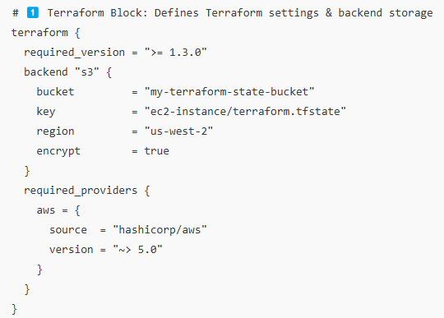
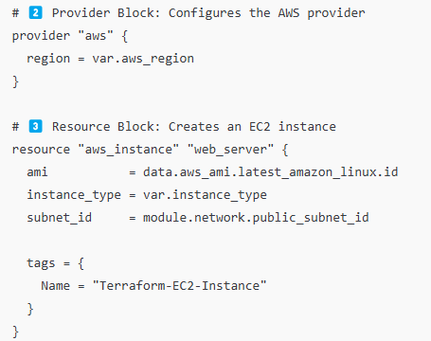
Terraform Structure
Here’s a Terraform configuration example that provisions an AWS EC2 instance, demonstrating how each block is used in Terraform's structure.
Provider Block
Resource Block
Terraform Block
You can define many more parameters including number of CPU cores, networking details and security groups for your EC2 instance here.

Slide 30
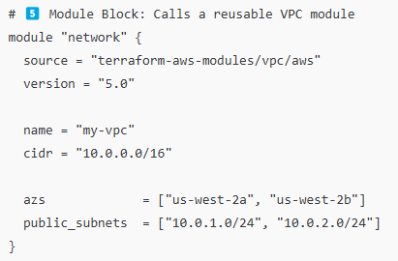
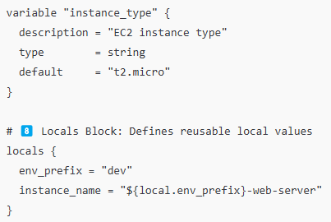
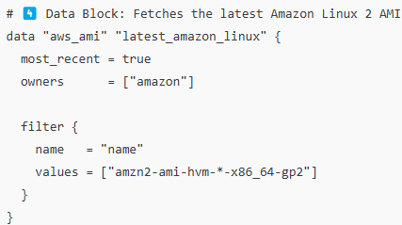
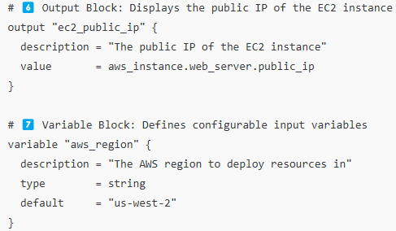
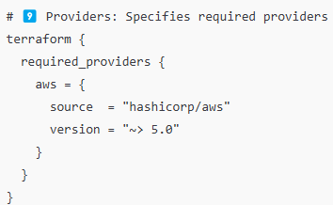
Terraform Structure
Module Block
Locals Block
Data Block
Output Block
Providers

Slide 31
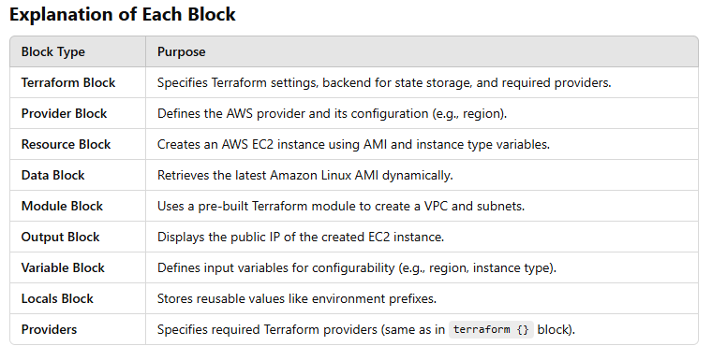
Terraform Structure
Terraform Block
Provider Block
Resource Block
Data Block
Module Block
Output Block
Variable Block
Locals Block
Providers

Slide 32
Terraform Configuration Files
main.tf
Primary configuration file where you define resources (e.g., EC2 instances, networking, databases).
providers.tf
Contains provider blocks (e.g., AWS, Azure, GCP) and associated configuration.
variables.tf
Defines input variables (their names, types, and optional descriptions).
terraform.tfvars
Provides default values for the variables defined in variables.tf.
outputs.tf
Contains output blocks to return values after terraform apply (e.g., instance IPs).
modules/ (Directory)
Contains reusable Terraform modules, each with its own main.tf, variables.tf, and outputs.tf.
.terraform.lock.hcl (Generated)
Auto-generated file that locks provider versions to ensure reproducible builds.
terraform.tfstate
It helps Terraform figure out what’s already been created, what needs to change, and what should be destroyed. Indeed, it is the Source of Truth for your entire Infrastructure created using Terraform.

Slide 33
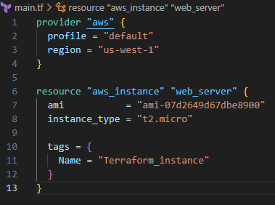
Terraform docs/exercise
2
To get more information about Ansible, you may visit: https://developer.hashicorp.com/terraform/docs
Check the following link to see details for AWS Provider (ec2/aws_instances):
https://registry.terraform.io/providers/hashicorp/aws/latest/docs/resources/instance
For creation of your own instance, you may use AMI-Catalog to find the AMI ID. Ensure to select a right Region before search for AMI ID.
Notes:
Travis Media YouTube Channel: https://www.youtube.com/watch?v=nvNqfgojocs

Slide 34
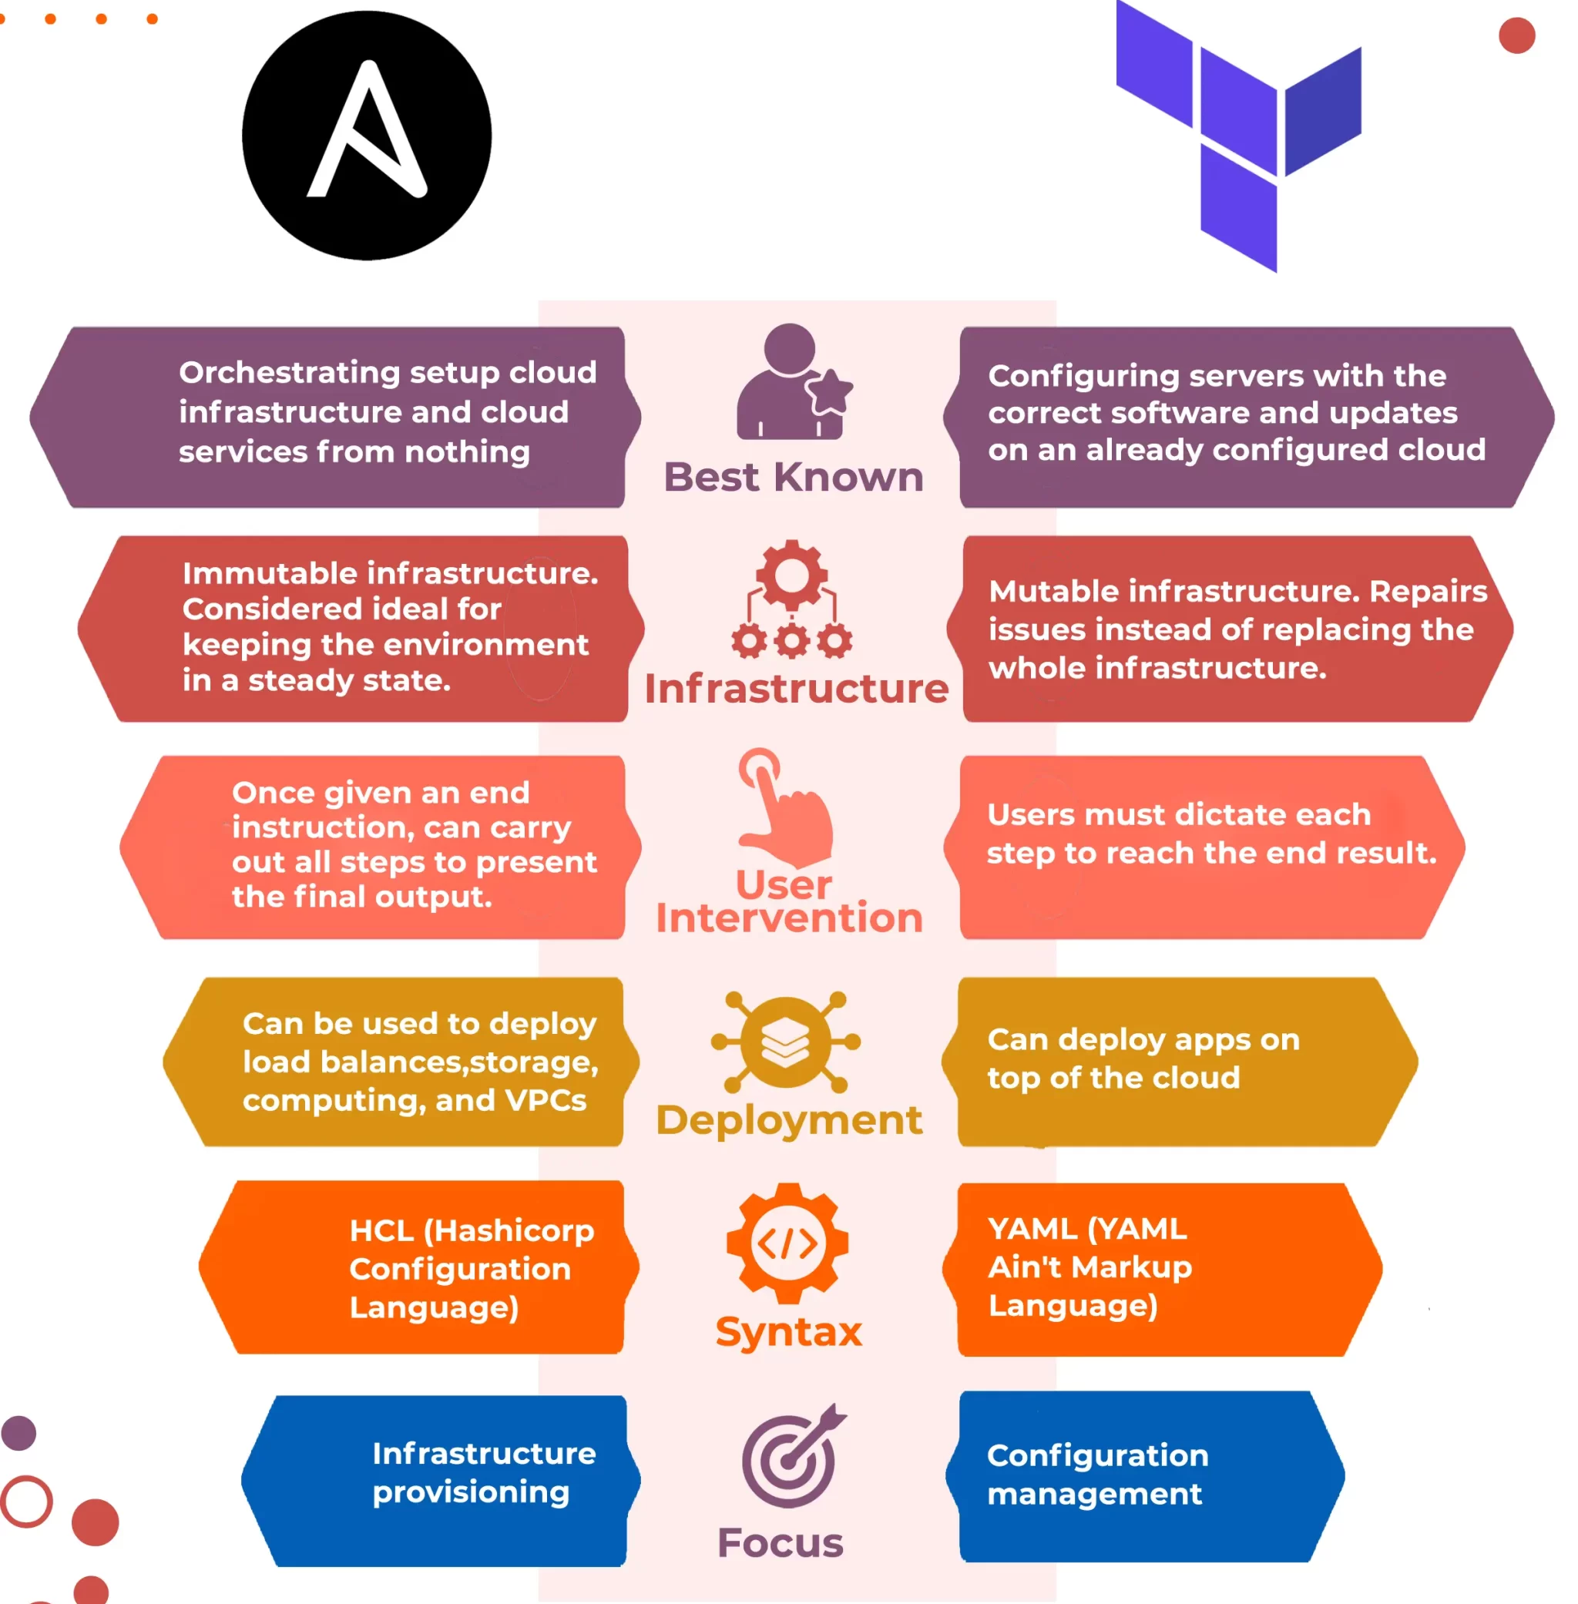
Ansible + Terraform
Check This Video (Red Hat)
https://www.youtube.com/watch?v=vQSDWa8MlN8
NetworkChuck (Ansible)
https://www.youtube.com/watch?v=5hycyr-8EKs
John Hammond (Terraform)
https://www.youtube.com/watch?v=a3vVUiLzm8w

Slide 35


End of Lecture #7
THANK Y☺U
- Dawood Sajjadi

